Slide 1

SIMPLE HARMONIC MOTION (SHM)
FISIKA DASAR 1

Slide 2
Start with force equation
Define x axis along direction spring is stretched and put x = 0 at the point the spring is unstretched
So, what is the solution to the differential equation?
Overview
Adopted from MIT Course

Slide 3
The answer is sine and/or cosine function with three mathematically equivalent ways to write it:
In all cases, A, B and φ are constants determined by the initial conditions
$ω$ is given by the physics: $ω=\sqrt{\frac{k}{m}}$
Overview
Adopted from MIT Course

Slide 4


Connections to the physical motion:
A is the amplitude, the maximum displacement from zero
Φ is an arbitrary constant that depends only on when you define t = 0, no real connection to the nature of the motion
Frequency in cycles/second
$$f=\frac{ω}{2π}=\frac{1}{2π}\sqrt{\frac{k}{m}}$$
Period (time for one cycle)
$$T=\frac{1}{f}=\frac{2π}{ω}=2π\sqrt{\frac{m}{k}}$$
Adopted from MIT Course

Slide 5

Example
A block whose mass m is 680 g is fastened to a spring whose spring constant k is 65 N/m. The block is pulled a distance x = 11 cm from its equilibrium position at x = 0 on a frictionless surface and released from rest at t = 0.
What are the angular frequency, the frequency, and the period of the resulting motion?
What is the amplitude of the oscillation?
What is the maximum speed $v_{m}$ of the oscillating block, and where is the block when it has this speed?
What is the magnitude $a_{m}$ of the maximum acceleration of the block?
What is the phase constant $ϕ$ for the motion?
What is the displacement function $x(t)$ for the spring–block system?
Adopted from Halliday & Resnick, Fundamentals of Physics, 10th edition, Wiley

Slide 6
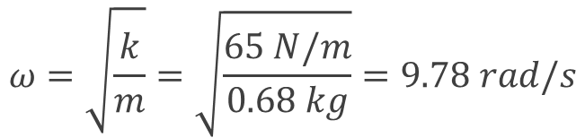
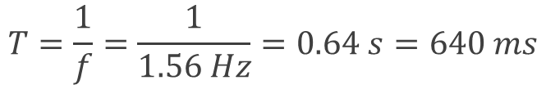

Key Idea (a)
The block–spring system forms a linear simple harmonic oscillator, with the block undergoing SHM.
Calculations: The angular frequency
$$ω=\sqrt{\frac{k}{m}}=\sqrt{\frac{65 N/m}{0.68 kg}}=9.78 rad/s$$
The frequency
$$f=\frac{ω}{2π}=\frac{9.78 rad/s}{2π rad}=1.56 Hz≈1.6 Hz$$
The period
$$T=\frac{1}{f}=\frac{1}{1.56 Hz}=0.64 s=640 ms$$
Adopted from Halliday & Resnick, Fundamentals of Physics, 10th edition, Wiley

Slide 7

Key Idea (b)
With no friction involved, the mechanical energy of the spring–block system is conserved.
Reasoning: The block is released from rest 11 cm from its equilibrium position, with zero kinetic energy and the elastic potential energy of the system at a maximum. Thus, the block will have zero kinetic energy whenever it is again 11 cm from its equilibrium position, which means it will never be farther than 11 cm from that position. Its maximum displacement is 11 cm:
$x_{m}$ = 11 cm.
Adopted from Halliday & Resnick, Fundamentals of Physics, 10th edition, Wiley

Slide 8
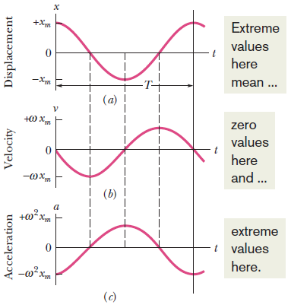


Key Idea (c)
The maximum speed $v_{m}$ is the velocity amplitude ${ωx}_{m}$ in
$$v\left(t\right)=−ωx_{m}\sin{(ωt+ϕ)}$$
Calculation: Thus, we have
$v_{m}=ωx_{m}=(9.78 rad/s$)$\left(0.11 m\right)=1.1 m/s$
This maximum speed occurs when the oscillating block is rushing through the origin; compare Figs. a and b, where you can see that the speed is a maximum whenever x = 0.
Adopted from Halliday & Resnick, Fundamentals of Physics, 10th edition, Wiley

Slide 9


Key Idea (d)
The magnitude $a_{m}$ of the maximum acceleration is the acceleration amplitude $ω^{2}x_{m}$ in $a\left(t\right)=−ω^{2}x_{m}\cos{(ωt+ϕ)}$
Calculation: So, we have
$$a_{m}=ω^{2}x_{m}=(9.78 rad/s)^{2}\left(0.11 m\right)$$
$$=11 m/s^{2}$$
This maximum acceleration occurs when the block is at the ends of its path, where the block has been slowed to a stop so that its motion can be reversed. At those extreme points, the force acting on the block has its maximum magnitude; compare Figs. a and c, where you can see that the magnitudes of the displacement and acceleration are maximum at the same times, when the speed is zero, as you can see in Fig. b.
Adopted from Halliday & Resnick, Fundamentals of Physics, 10th edition, Wiley

Slide 10
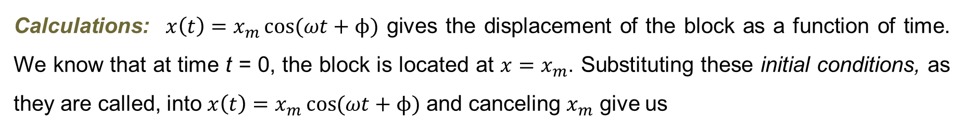


(e)
Calculations: $x\left(t\right)=x_{m}\cos{(ωt+ϕ)}$ gives the displacement of the block as a function of time. We know that at time t = 0, the block is located at ${x=x}_{m}$. Substituting these initial conditions, as they are called, into $x\left(t\right)=x_{m}\cos{(ωt+ϕ)}$ and canceling $x_{m}$ give us
$$1=\cos{ϕ}$$
Taking the inverse cosine then yields
$$ϕ=0 rad$$
Adopted from Halliday & Resnick, Fundamentals of Physics, 10th edition, Wiley

Slide 11



(f)
Calculations: The function x(t) is given in general form by $x\left(t\right)=x_{m}\cos{(ωt+ϕ)}$. Substituting known quantities into that equation gives us
$$x\left(t\right)=x_{m}\cos{(ωt+ϕ)}$$
$=\left(0.11 m\right)cos⁡[(9.8 rad/s$)$t+0]$
$$=0.11\cos{(9.8t)}$$
where x is in meters and t is in seconds.
Adopted from Halliday & Resnick, Fundamentals of Physics, 10th edition, Wiley

Slide 12
THANK YOU

